Slide 1
Real-Time Event Driven Stream Processing- Understand it simple Way
By: Ahmad Mohsin
ahmadspm@gmail.com

Slide 2
Real-Time Streaming – A metaphor

Slide 3
Real Time Fraud Detection
Fraud detection is a topic applicable to many industries, including banking and financial sectors, insurance, government agencies and law enforcement and more.
Fraud attempts have seen a drastic increase in recent years, making fraud detection more important than ever. Despite efforts on the part of the affected institutions, hundreds of millions of dollars are lost to fraud every year. Since relatively few cases show fraud in a large population, finding these can be tricky.
For Example in Banking Sector, stolen Credit Cards / Deibit cards may be misused.
But how to track and detect such type of activity in real-time and take further action?

Slide 4
We’re going to see how we can take a stream of inbound ATM transactions and easily set up an application to detect transactions that look fraudulent. three key factors are used to determine if we think a transaction is fraudulent:
The same account number as a previous transaction…
…but at a different location
…less than 10 minutes after the previous one

Slide 5
Scenario
ATM machines are used for stolen ATM cards or so.
Here we see how ATM transactions are captured in real-time and how to detect and get informed any suspicious tranaction.

Slide 6
Normal Transactions
{"account_id": "ac_01", "atm": "ID_2276369282", "amount": 20, "location": {"lat": "38.6956033", "lon": "-121.5922283"}, "transaction_id": "01"} {"account_id": "ac_02", "atm": "Flying Pig Bistro", "amount": 400, "location": {"lat": "37.766319", "lon": "-122.417422"}, "transaction_id": "02"} {"account_id": "ac_03", "atm": "Wells Fargo", "amount": 50, "location": {"lat": "37.5522855", "lon": "-121.9797997"}, "transaction_id": "04"}

Slide 7
Suspicious activity
{"account_id": "ac_02", "atm": "Flying Pig Bistro", "amount": 40, "location": {"lat": "37.766319", "lon": "-122.417422"}, "transaction_id": "03"} {"account_id": "ac_03", "atm": "Barclays", "amount": 500, "location": {"lat": "33.5522855", "lon": "-120.9797997"}, "transaction_id": "X05"}

Slide 8
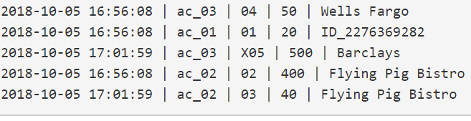
Suspicious

Slide 9
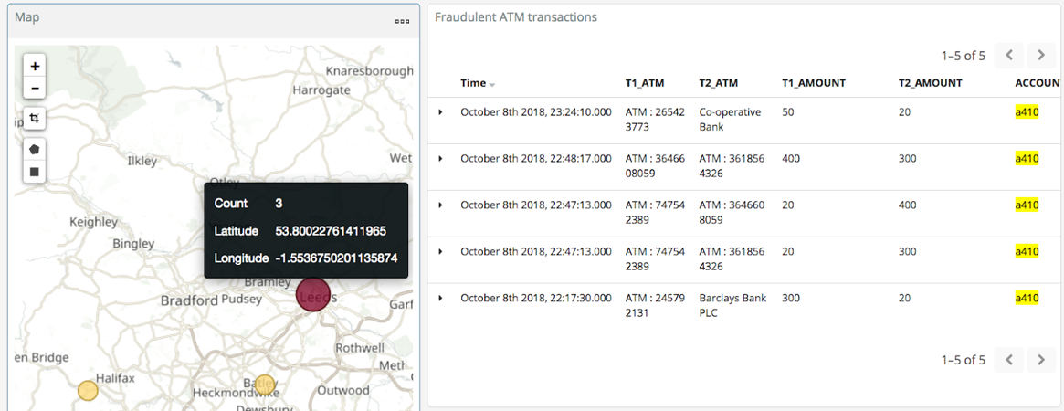
Visualize in Real-Time

Slide 10
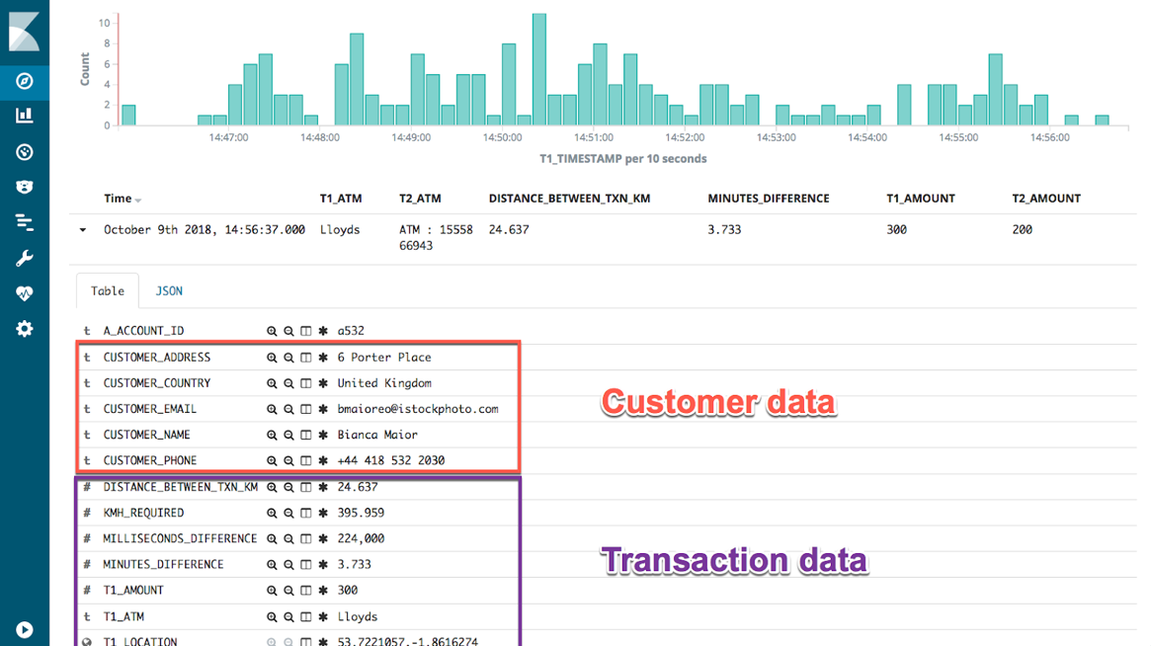
Analyse and Send Alerts in near real-time

Slide 11
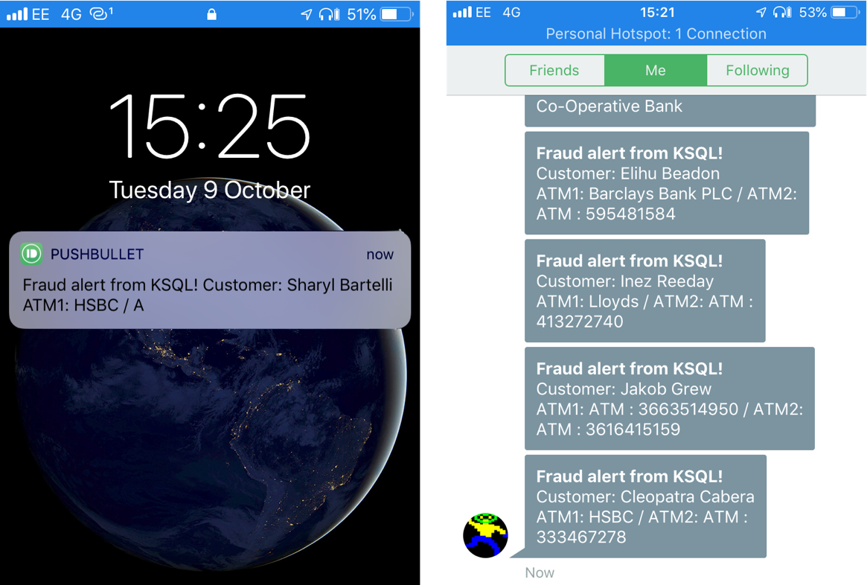
Analyse and Send Alerts in near real-time

Slide 12
How it realates to a Typical System i.e. LMS
is it possible to capture the digital traces (events, activities you name it) of learning activities of students and teachers in virtual learning environments(Various LMS Modules), offering stakeholders (teachers, parents and reloaded decision makers) potentially valuable insights into how students react during different leaning stages.

Slide 13
Why it is needed? The Real-Time
Teachers and parents are already receiving feedback from students but it is face to face only.
Can analytics be perfumed?
Capturing Data through digital learning environments can be a way forward.
Is it batch oriented or real-time?

Slide 14
Analysing Events Streams
Analysing data stream that come continuously from LMS can greatly help stakeholders to track students’ progress in courses and detect the students at risk.

Slide 15
Possible areas
Students individual learning
Course contents interactions / resource utilization.
Online engagement
Student’s weak areas
Student’s strong areas
Student’s specific aptitudes towards certain topics of interest.

Slide 16
Some Real-Time Views
Average time spent by a student on a particular activity.
What content/topic or activity a student likes more.
On overall view of student’s learning trends

Slide 17
Take Actions
How to improve curriculum based on students actions / activities / performances analytics.
How to get a student out of trouble.
How to make student learning journey smooth
How to decrease difficulties in a certain areas.

Slide 18
Continuous Assessments
…..
….
There could by many..

Slide 19
Some Random examples from LMS

Slide 20
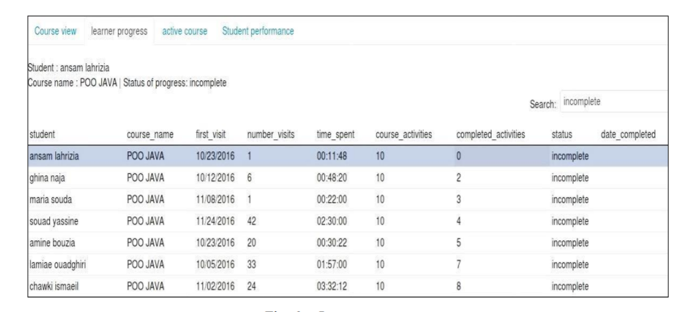
Learner’s Progress Monitoring

Slide 21
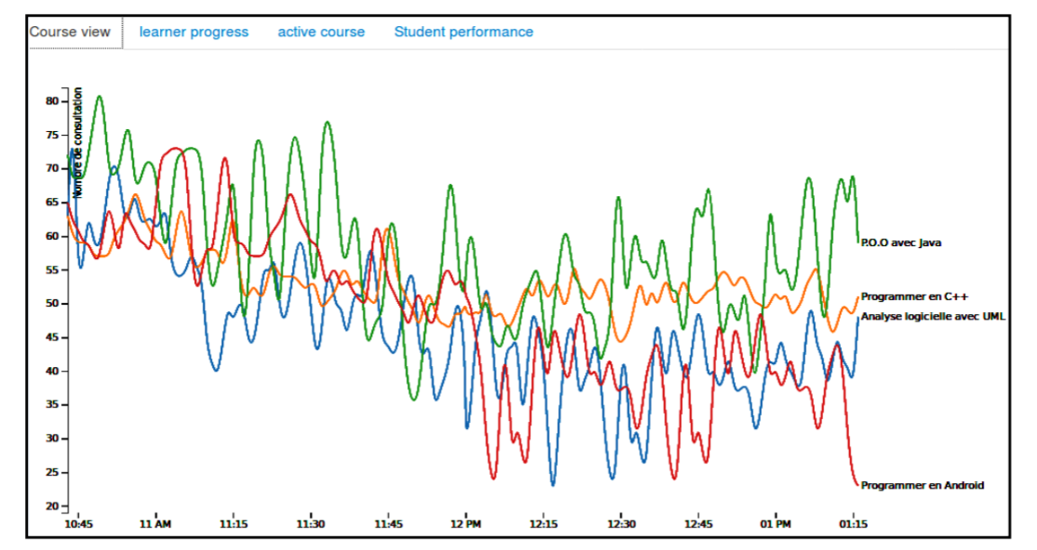
Course related activities

Slide 22
Refrences
Chaffai, Abdelmajid, Larbi Hassouni, and Houda Anoun. "Real-time analysis of students activities on an e-learning platform based on apache spark." IJACSA) International Journal of Advanced Computer Science And Applications 8, no. 7 (2017): 101-109.
ATM Fraud Detection with Apache Kafka and KSQL: https://www.confluent.io/blog/atm-fraud-detection-apache-kafka-ksql

